Slide 1
Graph Theory
Dr. Machbah Uddin
Associate Professor
Dept of Computer Science and Mathematics, BAU
machbah.csm@bau.edu.bd

Slide 2
Modern Applications of Graphs
Social Network Analysis
Recommendation Systems (Graph-based collaborative filtering)
Knowledge Graphs (Google, IBM Watson)
Bioinformatics (Gene interaction networks)
Traffic and Navigation Systems (Google Maps)

Slide 3
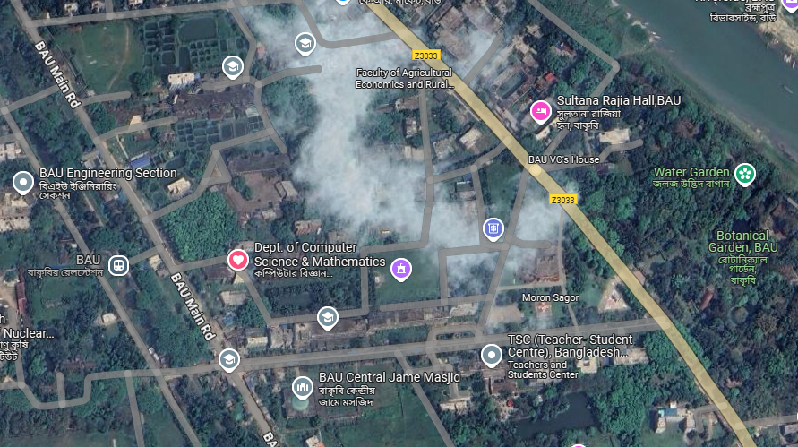

Slide 4
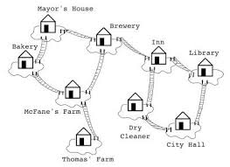
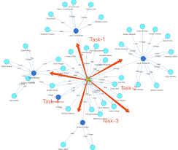
Applications

Slide 5
Graphs in Bioinformatics
Protein-protein interaction networks
Gene regulatory networks
Pathway and metabolic graphs
Phylogenetic trees and sequence alignment

Slide 6
Graph Algorithms
Dijkstra’s Algorithm – Shortest Path
Kruskal’s and Prim’s Algorithm – Minimum Spanning Tree
Topological Sorting
A* and Bellman-Ford Algorithms

Slide 7
Challenges in Graph Usage
Scalability in large-scale graphs
Dynamic graph updates
Efficient storage and processing
Visualization complexity

Slide 8
Graph Databases
Neo4j, Amazon Neptune, ArangoDB
Use cases in real-time data analytics
Querying graphs using Cypher

Slide 9
Recent Research Trends
Graph Neural Networks (GNNs)
Temporal and Dynamic Graphs
Graph Mining and Pattern Discovery
Graph-based Machine Learning
Heterogeneous Graphs and Multi-modal Analysis

Slide 10
Varying Applications (examples)
Computer networks
Distinguish between two chemical compounds with the same molecular formula but different structures
Solve shortest path problems between cities
Scheduling exams and assign channels to television stations

Slide 11
What is a graph?
Graphs represent the relationships among data items
A graph G consists of
  a set V of nodes (vertices)
  a set E of edges: each edge connects two nodes
Each node represents an item
Each edge represents the relationship between two items
node
edge
115/11/08
CS201

Slide 12
Examples of graphs
Molecular Structure
Computer Network
H
Server 1
Terminal 1
H
C
H
Terminal 2
H
Server 2
Other examples: electrical and communication networks, airline routes, flow chart, graphs for planning projects
115/11/08
CS201

Slide 13
Definitions - Graph
A generalization of the simple concept of a set of dots, links, edges or arcs.
Representation: Graph G =(V, E) consists set of vertices denoted by V, or by V(G) and set of edges E, or E(G)

Slide 14
Formal Definition of graph
The set of nodes is denoted as V
For any nodes u and v, if u and v are connected by an edge, such edge is denoted as (u, v)
The set of edges is denoted as E
A graph G is defined as a pair (V, E)
v
(u, v)
u
115/11/08
CS201

Slide 15
Definitions – Edge Type
Directed: Ordered pair of vertices. Represented as (u, v) directed from vertex u to v.
Undirected: Unordered pair of vertices. Represented as {u, v}. Disregards any sense of direction and treats both end vertices interchangeably.
u
v
u
v

Slide 16
Definitions – Edge Type
Loop: A loop is an edge whose endpoints are equal i.e., an edge joining a vertex to it self is called a loop. Represented as {u, u} = {u}
Multiple Edges: Two or more edges joining the same pair of vertices.
u

Slide 17
Adjacent
Two nodes u and v are said to be adjacent if (u, v) ∈ E
v
(u, v)
u
u and v are adjacent
v and w are not adjacent
w
115/11/08
CS201

Slide 18
Definitions – Graph Type
Simple (Undirected) Graph: consists of V, a nonempty set of vertices, and E, a set of unordered pairs of distinct elements of V called edges (undirected)
Representation Example: G(V, E), V = {u, v, w}, E = {{u, v}, {v, w}, {u, w}}
u
v
w

Slide 19
Definitions – Graph Type
Multigraph: G(V,E), consists of set of vertices V, set of Edges E and a function f from E to {{u, v}| u, v V, u ≠ v}. The edges e1 and e2 are called multiple or parallel edges if f (e1) = f (e2).
Representation Example: V = {u, v, w}, E = {e₁, e₂, e₃}
u
e₁
e₂
w
v
e₃

Slide 20
Definitions – Graph Type
Pseudograph: G(V,E), consists of set of vertices V, set of Edges E and a function F from E to {{u, v}| u, v Î V}. Loops allowed in such a graph.
Representation Example: V = {u, v, w}, E = {e₁, e₂, e₃, e₄}
u
e₁
w
e₄
e₂
v
e₃

Slide 21
Definitions – Graph Type
Directed Graph: G(V, E), set of vertices V, and set of Edges E, that are ordered pair of elements of V (directed edges)
Representation Example: G(V, E), V = {u, v, w}, E = {(u, v), (v, w), (w, u)}
u
v
w

Slide 22
Definitions – Graph Type
Directed Multigraph: G(V,E), consists of set of vertices V, set of Edges E and a function f from E to {{u, v}| u, v V}. The edges e1 and e2 are multiple edges if f(e1) = f(e2)
Representation Example: V = {u, v, w}, E = {e₁, e₂, e₃, e₄}
u
w
e₄
e₁
e₂
v
e₃

Slide 23
Definitions – Graph Type
Type | Edges | Multiple Edges Allowed ? | Loops Allowed ?
Simple Graph | undirected | No | No
Multigraph | undirected | Yes | No
Pseudograph | undirected | Yes | Yes
Directed Graph | directed | No | Yes
Directed Multigraph | directed | Yes | Yes

Slide 24
Terminology – Undirected graphs
u and v are adjacent if {u, v} is an edge, e is called incident with u and v. u and v are called endpoints of {u, v}
Degree of Vertex (deg (v)): the number of edges incident on a vertex. A loop contributes twice to the degree (why?).
Pendant Vertex: deg (v) =1
Isolated Vertex: deg (k) = 0
Representation Example: For V = {u, v, w} , E = { {u, w}, {u, v} }, deg (u) = 2, deg (v) = 1, deg (w) = 1, deg (k) = 0, w and v are pendant , k is isolated
u
v
k
w

Slide 25
Terminology – Directed graphs
For the edge (u, v), u is adjacent to v OR v is adjacent from u, u – Initial vertex, v – Terminal vertex
In-degree (deg⁻ (u)): number of edges for which u is terminal vertex
Out-degree (deg⁺ (u)): number of edges for which u is initial vertex
Note: A loop contributes 1 to both in-degree and out-degree (why?)
Representation Example: For V = {u, v, w} , E = { (u, w), ( v, w), (u, v) }, deg⁻ (u) = 0, deg⁺ (u) = 2, deg⁻ (v) = 1,
deg⁺ (v) = 1, and deg⁻ (w) = 2, deg⁺ (u) = 0
u
v
w

Slide 26
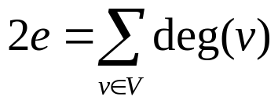
Theorems: Undirected Graphs
Theorem 1
The Handshaking theorem:
(why?) Every edge connects 2 vertices

Slide 27
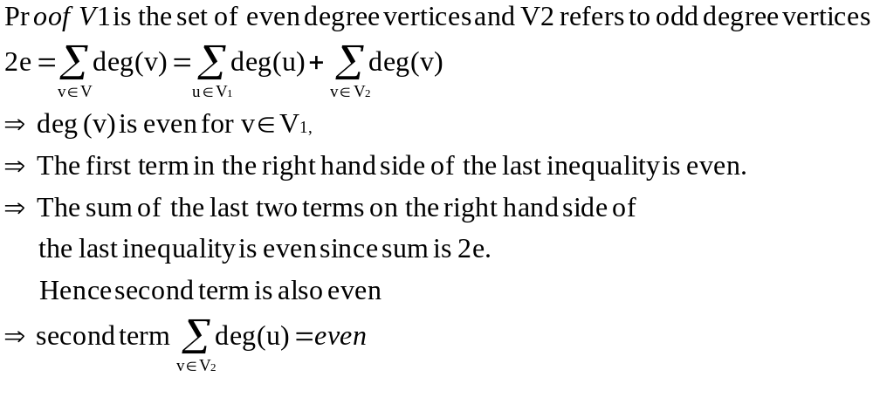
Theorems: Undirected Graphs
Theorem 2:
An undirected graph has even number of vertices with odd degree

Slide 28

Theorems: directed Graphs
Theorem 3: deg ⁺ (u) = deg ⁻ (u) = |E|

Slide 29
Simple graphs – special cases
Complete graph: K_{n}, is the simple graph that contains exactly one edge between each pair of distinct vertices.
Representation Example: K₁, K₂, K₃, K₄
K₁
K₂
K₃
K₄

Slide 30
Simple graphs – special cases
Cycle: C_{n}, n ≥ 3 consists of n vertices v₁, v₂, v₃ … v_{n} and edges {v₁, v₂}, {v₂, v₃}, {v₃, v₄} … {v_{n-1}, v_{n}}, {v_{n}, v₁}
Representation Example: C₃, C₄
C₃
C₄

Slide 31
Simple graphs – special cases
Wheels: W_{n}, obtained by adding additional vertex to Cn and connecting all vertices to this new vertex by new edges.
Representation Example: W₃, W₄
W₃
W₄

Slide 32
Simple graphs – special cases
N-cubes: Q_{n}, vertices represented by 2n bit strings of length n. Two vertices are adjacent if and only if the bit strings that they represent differ by exactly one bit positions
Representation Example: Q₁, Q₂
10
11
0
1
00
01
Q₁
Q₂

Slide 33
Connected graph
A graph G is connected if there exists path between every pair of distinct nodes; otherwise, it is disconnected
v₂
v₁
v₃
v₅
v₄
This is a connected graph because there exists path between every pair of nodes

Slide 34
Example of disconnected graph
v₃
v₇
v₈
v₁
v₂
v₅
v₄
v₆
v₉
This is a disconnected graph because there does not exist path between some pair of nodes, says, v₁ and v₇

Slide 35
Connected component
If a graph is disconnect, it can be partitioned into a number of graphs such that each of them is connected. Each such graph is called a connected component.
v₂
v₇
v₈
v₁
v₃
v₅
v₄
v₆
v₉

Slide 36
Complete graph
A graph is complete if each pair of distinct nodes has an edge
Complete graph
with 3 nodes
Complete graph
with 4 nodes

Slide 37
Bipartite graphs
In a simple graph G, if V can be partitioned into two disjoint sets V₁ and V₂ such that every edge in the graph connects a vertex in V₁ and a vertex V₂ (so that no edge in G connects either two vertices in V₁ or two vertices in V₂)
Application example: Representing Relations
Representation example: V₁ = {v₁, v₂, v₃} and V₂ = {v₄, v₅, v₆},
v₁
v₄
v₂
v₅
v₃
v₆
V₁
V₂

Slide 38
Complete Bipartite graphs
K_{m,n} is the graph that has its vertex set portioned into two subsets of m and n vertices, respectively There is an edge between two vertices if and only if one vertex is in the first subset and the other vertex is in the second subset.
Representation example: K_{2,3,} K_{3,3}
K_{2,3}
K_{3,3}

Slide 39
Subgraphs
A subgraph of a graph G = (V, E) is a graph H =(V’, E’) where V’ is a subset of V and E’ is a subset of E
Application example: solving sub-problems within a graph
Representation example: V = {u, v, w}, E = ({u, v}, {v, w}, {w, u}}, H₁ , H₂
u
u
u
v
w
v
w
v
G
H₁
H₂

Slide 40
Subgraphs
G = G1 U G2 wherein E = E1 U E2 and V = V1 U V2, G, G1 and G2 are simple graphs of G
Representation example: V1 = {u, w}, E1 = {{u, w}}, V2 = {w, v},
E1 = {{w, v}}, V = {u, v ,w}, E = {{{u, w}, {{w, v}}
u
u
w
v
w
w
v
G1
G2
G

Slide 41
Representation
Incidence (Matrix): Most useful when information about edges is more desirable than information about vertices.
Adjacency (Matrix/List): Most useful when information about the vertices is more desirable than information about the edges. These two representations are also most popular since information about the vertices is often more desirable than edges in most applications

Slide 42
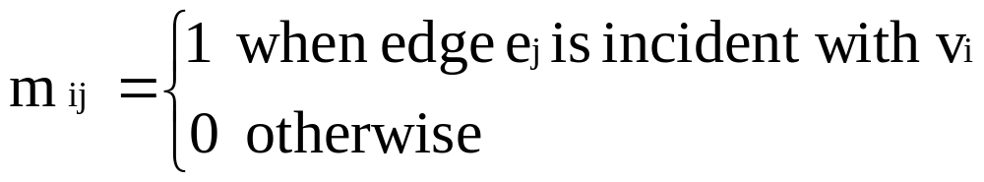
Representation- Incidence Matrix
G = (V, E) be an unditected graph. Suppose that v₁, v₂, v₃, …, v_{n} are the vertices and e₁, e₂, …, e_{m} are the edges of G. Then the incidence matrix with respect to this ordering of V and E is the nx m matrix M = [m _{ij}], where
Can also be used to represent :
Multiple edges: by using columns with identical entries, since these edges are incident with the same pair of vertices
Loops: by using a column with exactly one entry equal to 1, corresponding to the vertex that is incident with the loop

Slide 43
Representation- Incidence Matrix
Representation Example: G = (V, E)
 | e₁ | e₂ | e₃
v | 1 | 0 | 1
u | 1 | 1 | 0
w | 0 | 1 | 1
u
e1
e2
v
w
e3

Slide 44
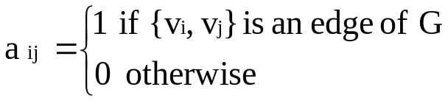

Representation- Adjacency Matrix
There is an N x N matrix, where |V| = N , the Adjacenct Matrix (NxN) A = [a_{ij}]
For undirected graph
For directed graph
This makes it easier to find subgraphs, and to reverse graphs if needed.

Slide 45
Representation- Adjacency Matrix
Adjacency is chosen on the ordering of vertices. Hence, there as are as many as n! such matrices.
The adjacency matrix of simple graphs are symmetric (a_{ij} = a_{ji}) (why?)
When there are relatively few edges in the graph the adjacency matrix is a sparse matrix
Directed Multigraphs can be represented by using aij = number of edges from v_{i} to v_{j}

Slide 46
Representation- Adjacency Matrix
Example: Undirected Graph G (V, E)
 | v | u | w
v | 0 | 1 | 1
u | 1 | 0 | 1
w | 1 | 1 | 0
u
v
w

Slide 47
Representation- Adjacency Matrix
Example: directed Graph G (V, E)
 | v | u | w
v | 0 | 1 | 0
u | 0 | 0 | 1
w | 1 | 0 | 0
u
v
w

Slide 48
Adjacency matrix for weighted undirected graph
Matrix[i][j] = w(v_{i}, v_{j}) if (v_{i}, v_{j})∈E or (v_{j}, v_{i})∈E
∞ otherwise
 |  | 1 | 2 | 3 | 4 | 5
 |  | v₁ | v₂ | v₃ | v₄ | v₅
1 | v₁ | ∞ | 5 | ∞ | ∞ | ∞
2 | v₂ | 5 | ∞ | 2 | 4 | ∞
3 | v₃ | 0 | 2 | ∞ | 3 | 7
4 | v₄ | ∞ | 4 | 3 | ∞ | 8
5 | v₅ | ∞ | ∞ | 7 | 8 | ∞
v₂
v₁
v₃
2
5
4
3
7
8
v₅
v₄
G
115/11/08
CS201

Slide 49
Representation- Adjacency List
Each node (vertex) has a list of which nodes (vertex) it is adjacent
Example: undirectd graph G (V, E)
u
node | Adjacency List
u | v , w
v | w, u
w | u , v
v
w

Slide 50
Adjacency list for directed graph
1 | v₁ | → | v₂
2 | v₂ | → | v₄
3 | v₃ | → | v₂ | → | v₄
4 | v₄
5 | v₅ | → | v₃ | → | v₄
v₂
v₁
v₃
v₅
v₄
G
115/11/08
CS201

Slide 51
Adjacency list for weighted undirected graph
v₂
v₁
v₃
2
1 | v₁ | → | v₂(5)
2 | v₂ | → | v₁(5) | → | v₃(2) | → | v₄(4)
3 | v₃ | → | v₂(2) | → | v₄(3) | → | v₅(7)
4 | v₄ | → | v₂(4) | → | v₃(3) | → | v₅(8)
5 | v₅ | → | v₃(7) | → | v₄(8)
5
4
3
7
8
v₅
v₄
G
115/11/08
CS201

Slide 52
Pros and Cons
Adjacency matrix
  Allows us to determine whether there is an edge from node i to node j in O(1) time
Adjacency list
  Allows us to find all nodes adjacent to a given node j efficiently
  If the graph is sparse, adjacency list requires less space
115/11/08
CS201

Slide 53
Graph - Isomorphism
G1 = (V1, E2) and G2 = (V2, E2) are isomorphic if:
There is a one-to-one and onto function f from V1 to V2 with the property that
  a and b are adjacent in G1 if and only if f (a) and f (b) are adjacent in G2, for all a and b in V1.
Function f is called isomorphism
Application Example:
In chemistry, to find if two compounds have the same structure

Slide 54
Graph - Isomorphism
Representation example: G1 = (V1, E1) , G2 = (V2, E2)
f(u₁) = v₁, f(u₂) = v₄, f(u₃) = v₃, f(u₄) = v₂,
u₁
u₂
v₁
v₂
u₃
u₄
v₄
v₃

Slide 55
Connectivity
Basic Idea: In a Graph Reachability among vertices by traversing the edges
Application Example:
- In a city to city road-network, if one city can be reached from another city.
- Problems if determining whether a message can be sent between two
computer using intermediate links
- Efficiently planning routes for data delivery in the Internet

Slide 56
Connectivity – Path
A Path is a sequence of edges that begins at a vertex of a graph and travels along edges of the graph, always connecting pairs of adjacent vertices.
Representation example: G = (V, E), Path P represented, from u to v is {{u, 1}, {1, 4}, {4, 5}, {5, v}}
2
1
v
3
u
4
5

Slide 57
Connectivity – Path
Definition for Directed Graphs
A Path of length n (> 0) from u to v in G is a sequence of n edges e₁, e₂ , e₃, …, e_{n} of G such that f (e₁) = (x_{o}, x₁), f (e₂) = (x₁, x₂₎, …, f (e_{n}) = (x_{n-1}, x_{n)}, where x₀ = u and x_{n} = v. A path is said to pass through x₀, x₁, …, x_{n} or traverse e₁, e₂ , e₃, …, e_{n}
For Simple Graphs, sequence is x₀, x₁, …, x_{n}
In directed multigraphs when it is not necessary to distinguish between their edges, we can use sequence of vertices to represent the path
Circuit/Cycle: u = v, length of path > 0
Simple Path: does not contain an edge more than once

Slide 58
Connectivity – Connectedness
Undirected Graph
An undirected graph is connected if there exists is a simple path between every pair of vertices
Representation Example: G (V, E) is connected since for V = {v₁, v₂, v₃, v₄, v₅}, there exists a path between {v_{i}, v_{j}}, 1 ≤ i, j≤ 5
v₄
v₁
v₃
v₂
v₅

Slide 59
Connectivity – Connectedness
Undirected Graph
Articulation Point (Cut vertex): removal of a vertex produces a subgraph with more connected components than in the original graph. The removal of a cut vertex from a connected graph produces a graph that is not connected
Cut Edge: An edge whose removal produces a subgraph with more connected components than in the original graph.
Representation example: G (V, E), v₃ is the articulation point or edge {v₂, v₃}, the number of connected components is 2 (> 1)
v₃
v₅
v₁
v₂
v₄

Slide 60
Connectivity – Connectedness
Directed Graph
A directed graph is strongly connected if there is a path from a to b and from b to a whenever a and b are vertices in the graph
A directed graph is weakly connected if there is a (undirected) path between every two vertices in the underlying undirected path
A strongly connected Graph can be weakly connected but the vice-versa is not true (why?)

Slide 61
Connectivity – Connectedness
Directed Graph
Representation example: G1 (Strong component), G2 (Weak Component), G3 is undirected graph representation of G2 or G1
G1
G2
G3

Slide 62
Connectivity – Connectedness
Directed Graph
Strongly connected Components: subgraphs of a Graph G that are strongly connected
Representation example: G1 is the strongly connected component in G
G
G1

Slide 63
Isomorphism - revisited
A isomorphic invariant for simple graphs is the existence of a simple circuit of length k , k is an integer > 2 (why ?)
Representation example: G1 and G2 are isomorphic since we have the invariants, similarity in degree of nodes, number of edges, length of circuits
G1
G2

Slide 64
Counting Paths
Theorem: Let G be a graph with adjacency matrix A with respect to the ordering v₁, v2, …, V_{n} (with directed on undirected edges, with multiple edges and loops allowed). The number of different paths of length r from Vi to Vj, where r is a positive integer, equals the (i, j)^{th} entry of (adjacency matrix) A^{r.}
Proof: By Mathematical Induction.
Base Case: For the case N = 1, a_{ij} =1 implies that there is a path of length 1. This is true since this corresponds to an edge between two vertices.
We assume that theorem is true for N = r and prove the same for N = r +1. Assume that the (i, j)^{th} entry of A^{r} is the number of different paths of length r from v_{i} to v_{j}. By induction hypothesis, b_{ik} is the number of paths of length r from v_{i} to v_{k}.

Slide 65
Counting Paths
Case r +1: In A^{r+1} = A^{r}. A,
The (i, j)^{th} entry in A^{r+1} , b_{i1}a_{1j} + b_{i2} a_{2j} + …+ b_{in} a_{nj}
where b_{ik} is the (i, j)^{th} entry of A^{r}.
By induction hypothesis, b_{ik} is the number of paths of length r from v_{i} to v_{k}.
The (i, j)^{th} entry in A^{r+1} corresponds to the length between i and j and the length is r+1. This path is made up of length r from v_{i} to v_{k} and of length from v_{k} to vj. By product rule for counting, the number of such paths is b_{ik*} a_{kj} The result is b_{i1}a_{1j} + b_{i2} a_{2j} + …+ b_{in} a_{nj ,}the desired result.

Slide 66
Counting Paths
a ------- b
| |
| |
c -------d
A = 0 1 1 0 A⁴ = 8 0 0 8
1 0 0 1 0 8 8 0
1 0 0 1 0 8 8 0
0 1 1 0 8 0 0 8
Number of paths of length 4 from a to d is (1,4) th entry of A⁴ = 8.

Slide 67
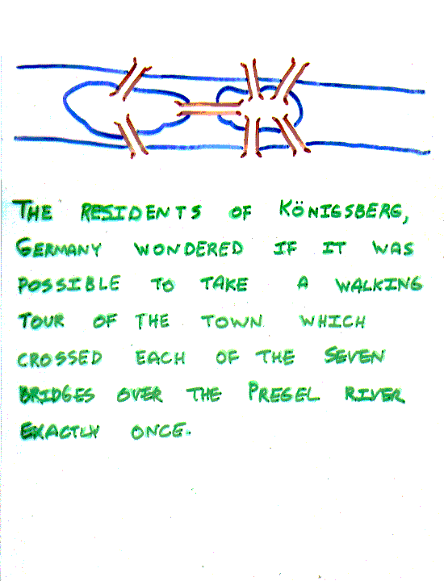
The Seven Bridges of Königsberg, Germany
The residents of Königsberg, Germany, wondered if it was possible to take a walking tour of the town that crossed each of the seven bridges over the Presel river exactly once. Is it possible to start at some node and take a walk that uses each edge exactly once, and ends at the starting node?

Slide 68
The Seven Bridges of Königsberg, Germany
You can redraw the original picture as long as for every edge between nodes i and j in the original you put an edge between nodes i and j in the redrawn version (and you put no other edges in the redrawn version).
Original:
2
3
4
Redrawn:
2
4
1
3

Slide 69
The Seven Bridges of Königsberg, Germany
Euler:
Has no tour that uses each edge exactly once.
(Even if we allow the walk to start and finish in different places.)
Can you see why?

Slide 70
Euler - definitions
An Eulerian path (Eulerian trail, Euler walk) in a graph is a path that uses each edge precisely once. If such a path exists, the graph is called traversable.
An Eulerian cycle (Eulerian circuit, Euler tour) in a graph is a cycle that uses each edge precisely once. If such a cycle exists, the graph is called Eulerian (also unicursal).
Representation example: G1 has Euler path a, c, d, e, b, d, a, b
a
b
c
d
e

Slide 71
The problem in our language:
Show that is not Eulerian.
In fact, it contains no Euler trail.

Slide 72
Euler - theorems
1. A connected graph G is Eulerian if and only if G is connected and has no vertices of odd degree
2. A connected graph G is has an Euler trail from node a to some other node b if and only if G is connected and a ≠ b are the only two nodes of odd degree

Slide 73
Euler – theorems (=>)
Assume G has an Euler trail T from node a to node b (a and b not necessarily distinct).
For every node besides a and b, T uses an edge to exit for each edge it uses to enter. Thus, the degree of the node is even.
1. If a = b, then a also has even degree. → Euler circuit
2. If a ≠ b, then a and b both have odd degree. → Euler path

Slide 74
Euler - theorems
1. A connected graph G is Eulerian if and only if G is connected and has no vertices of odd degree
a
b
f
c
d
Building a simple path:
{a,b}, {b,c}, {c,f}, {f,a}
Euler circuit constructed if all edges
are used. True here?
e

Slide 75
Euler - theorems
1. A connected graph G is Eulerian if and only if G is connected and has no vertices of odd degree
c
d
e
Delete the simple path:
{a,b}, {b,c}, {c,f}, {f,a}
C is the common vertex for this
sub-graph with its “parent”.

Slide 76
Euler - theorems
1. A connected graph G is Eulerian if and only if G is connected and has no vertices of odd degree
c
d
Constructed subgraph may not be connected.
C is the common vertex for this sub-graph
with its “parent”.
C has even degree.
Start at c and take a walk:
{c,d}, {d,e}, {e,c}
e

Slide 77
Euler - theorems
1. A connected graph G is Eulerian if and only if G is connected and has no vertices of odd degree
a
b
f
c
d
“Splice” the circuits in the 2 graphs:
{a,b}, {b,c}, {c,f}, {f,a}
“+”
{c,d}, {d,e}, {e,c}
“=“
{a,b}, {b,c}, {c,d}, {d,e}, {e,c}, {c,f}
{f,a}
e

Slide 78
Euler Circuit
Circuit C := a circuit in G beginning at an arbitrary vertex v.
  Add edges successively to form a path that returns to this vertex.
H := G – above circuit C
While H has edges
  Sub-circuit sc := a circuit that begins at a vertex in H that is also in C (e.g., vertex “c”)
  H := H – sc (- all isolated vertices)
  Circuit := circuit C “spliced” with sub-circuit sc
Circuit C has the Euler circuit.

Slide 79
Representation- Incidence Matrix
 | e₁ | e₂ | e₃
a | 1 | 0 | 0
b | 1 | 1 | 0
c | 0 | 1 | 1
d | 0 | 0 | 1
e | 0 | 0 | 0
f | 0 | 0 | 0
e4 | e₅ | e₆ | e₇
0 | 0 | 0 | 1
0 | 0 | 0 | 0
0 | 1 | 1 | 0
1 | 0 | 0 | 0
1 | 1 | 0 | 0
0 | 0 | 1 | 1
e1
a
b
e7
e2
e3
f
c
d
e6
e5
e
e4

Slide 80
Hamiltonian Graph
Hamiltonian path (also called traceable path) is a path that visits each vertex exactly once.
A Hamiltonian cycle (also called Hamiltonian circuit, vertex tour or graph cycle) is a cycle that visits each vertex exactly once (except for the starting vertex, which is visited once at the start and once again at the end).
A graph that contains a Hamiltonian path is called a traceable graph. A graph that contains a Hamiltonian cycle is called a Hamiltonian graph. Any Hamiltonian cycle can be converted to a Hamiltonian path by removing one of its edges, but a Hamiltonian path can be extended to Hamiltonian cycle only if its endpoints are adjacent.

Slide 81
A graph of the vertices of a dodecahedron.
Is it Hamiltonian?
Yes.

Slide 82
This one has a Hamiltonian path, but not a Hamiltonian tour.
Hamiltonian Graph

Slide 83
Hamiltonian Graph
This one has an Euler tour, but no Hamiltonian path.

Slide 84
Hamiltonian Graph
Similar notions may be defined for directed graphs, where edges (arcs) of a path or a cycle are required to point in the same direction, i.e., connected tail-to-head.
The Hamiltonian cycle problem or Hamiltonian circuit problem in graph theory is to find a Hamiltonian cycle in a given graph. The Hamiltonian path problem is to find a Hamiltonian path in a given graph.
There is a simple relation between the two problems. The Hamiltonian path problem for graph G is equivalent to the Hamiltonian cycle problem in a graph H obtained from G by adding a new vertex and connecting it to all vertices of G.
Both problems are NP-complete. However, certain classes of graphs always contain Hamiltonian paths. For example, it is known that every tournament has an odd number of Hamiltonian paths.

Slide 85
Hamiltonian Graph
DIRAC’S Theorem: if G is a simple graph with n vertices with n ≥ 3 such that the degree of every vertex in G is at least n/2 then G has a Hamilton circuit.
ORE’S Theorem: if G is a simple graph with n vertices with n ≥ 3 such that deg (u) + deg (v) ≥ n for every pair of nonadjacent vertices u and v in G, then G has a Hamilton circuit.

Slide 86

Shortest Path
Generalize distance to weighted setting
Digraph G = (V,E) with weight function W: E → R (assigning real values to edges)
Weight of path p = v₁ → v₂ → … → v_{k} is
Shortest path = a path of the minimum weight
Applications
  static/dynamic network routing
  robot motion planning
  map/route generation in traffic

Slide 87
Shortest-Path Problems
Shortest-Path problems
  Single-source (single-destination). Find a shortest path from a given source (vertex s) to each of the vertices. The topic of this lecture.
  Single-pair. Given two vertices, find a shortest path between them. Solution to single-source problem solves this problem efficiently, too.
  All-pairs. Find shortest-paths for every pair of vertices. Dynamic programming algorithm.
  Unweighted shortest-paths – BFS.

Slide 88

Optimal Substructure
Theorem: subpaths of shortest paths are shortest paths
Proof (”cut and paste”)
  if some subpath were not the shortest path, one could substitute the shorter subpath and create a shorter total path

Slide 89
Negative Weights and Cycles?
Negative edges are OK, as long as there are no negative weight cycles (otherwise paths with arbitrary small “lengths” would be possible)
Shortest-paths can have no cycles (otherwise we could improve them by removing cycles)
  Any shortest-path in graph G can be no longer than n – 1 edges, where n is the number of vertices

Slide 90
Shortest Path Tree
The result of the algorithms – a shortest path tree. For each vertex v, it
  records a shortest path from the start vertex s to v. v.parent() gives a predecessor of v in this shortest path
  gives a shortest path length from s to v, which is recorded in v.d().
The same pseudo-code assumptions are used.
Vertex ADT with operations:
  adjacent():VertexSet
  d():int and setd(k:int)
  parent():Vertex and setparent(p:Vertex)

Slide 91
Relaxation
For each vertex v in the graph, we maintain v.d(), the estimate of the shortest path from s, initialized to ∞ at the start
Relaxing an edge (u,v) means testing whether we can improve the shortest path to v found so far by going through u
u
v
u
v
2
2
Relax (u,v,G)
if v.d() > u.d()+G.w(u,v) then
v.setd(u.d()+G.w(u,v))
v.setparent(u)
5
9
5
6
Relax(u,v)
Relax(u,v)
5
7
5
6
2
2
u
v
u
v

Slide 92
Dijkstra's Algorithm
Non-negative edge weights
Greedy, similar to Prim's algorithm for MST
Like breadth-first search (if all weights = 1, one can simply use BFS)
Use Q, a priority queue ADT keyed by v.d() (BFS used FIFO queue, here we use a PQ, which is re-organized whenever some d decreases)
Basic idea
  maintain a set S of solved vertices
  at each step select "closest" vertex u, add it to S, and relax all edges from u

Slide 93
Dijkstra’s ALgorithm
Solution to Single-source (single-destination).
Input: Graph G, start vertex s
Dijkstra(G,s)
01 for each vertex u ∈ G.V()
02 u.setd(∞)
03 u.setparent(NIL)
04 s.setd(0)
05 S ← ∅ // Set S is used to explain the algorithm
06 Q.init(G.V()) // Q is a priority queue ADT
07 while not Q.isEmpty()
08 u ← Q.extractMin()
09 S ← S ∪ {u}
10 for each v ∈ u.adjacent() do
11 Relax(u, v, G)
12 Q.modifyKey(v)
relaxing edges

Slide 94
Dijkstra’s Example
u
v
1
10
∞
∞
Dijkstra(G,s)
01 for each vertex u ∈ G.V()
02 u.setd(∞)
03 u.setparent(NIL)
04 s.setd(0)
05 S ← ∅
06 Q.init(G.V())
07 while not Q.isEmpty()
08 u ← Q.extractMin()
09 S ← S ∪ {u}
10 for each v ∈ u.adjacent() do
11 Relax(u, v, G)
12 Q.modifyKey(v)
9
s
0
2
3
4
6
7
5
∞
∞
2
x
y
u
v
1
10
10
∞
9
s
0
2
3
4
6
7
5
5
∞
2
x
y

Slide 95
Dijkstra’s Example
u
v
1
10
8
14
Dijkstra(G,s)
01 for each vertex u ∈ G.V()
02 u.setd(∞)
03 u.setparent(NIL)
04 s.setd(0)
05 S ← ∅
06 Q.init(G.V())
07 while not Q.isEmpty()
08 u ← Q.extractMin()
09 S ← S ∪ {u}
10 for each v ∈ u.adjacent() do
11 Relax(u, v, G)
12 Q.modifyKey(v)
9
s
0
2
3
4
6
7
5
5
7
2
x
y
u
v
1
10
8
13
9
s
0
2
3
4
6
7
5
5
7
2
x
y

Slide 96
Dijkstra’s Example
u
v
1
10
8
9
Dijkstra(G,s)
01 for each vertex u ∈ G.V()
02 u.setd(∞)
03 u.setparent(NIL)
04 s.setd(0)
05 S ← ∅
06 Q.init(G.V())
07 while not Q.isEmpty()
08 u ← Q.extractMin()
09 S ← S ∪ {u}
10 for each v ∈ u.adjacent() do
11 Relax(u, v, G)
12 Q.modifyKey(v)
9
0
2
3
4
6
7
5
5
7
2
x
y
u
v
1
10
8
9
9
0
2
3
4
6
7
5
5
7
2
x
y

Slide 97
Dijkstra’s Algorithm
O(n²) operations
  (n-1) iterations: 1 for each vertex added to the distinguished set S.
  (n-1) iterations: for each adjacent vertex of the one added to the distinguished set.
Note: it is single source – single destination algorithm

Slide 98
Traveling Salesman Problem
Given a number of cities and the costs of traveling from one to the other, what is the cheapest roundtrip route that visits each city once and then returns to the starting city?
An equivalent formulation in terms of graph theory is: Find the Hamiltonian cycle with the least weight in a weighted graph.
It can be shown that the requirement of returning to the starting city does not change the computational complexity of the problem.
A related problem is the (bottleneck TSP): Find the Hamiltonian cycle in a weighted graph with the minimal length of the longest edge.

Slide 99
Planar Graphs
A graph (or multigraph) G is called planar if G can be drawn in the plane with its edges intersecting only at vertices of G, such a drawing of G is called an embedding of G in the plane.
Application Example: VLSI design (overlapping edges requires extra layers), Circuit design (cannot overlap wires on board)
Representation examples: K1,K2,K3,K4 are planar, Kn for n>4 are non-planar
K₄

Slide 100
Planar Graphs
Representation examples: Q₃

Slide 101
Planar Graphs
Representation examples: K_{3,3} is Nonplanar
v₁
v₂
v₃
v₁
v₅
v₁
v₅
R₂₁
R₂
R₁
R₁
R₂₂
v₃
v₄
v₅
v₆
v₄
v₂
v₄
v₂

Slide 102
Planar Graphs
Theorem : Euler's planar graph theorem
For a connected planar graph or multigraph:
v – e + r = 2
number
of regions
number
of vertices
number
of edges

Slide 103
Planar Graphs
Example of Euler’s theorem
A planar graph divides the plane
into several regions (faces), one
of them is the infinite region.
R1
K₄
R4
R2
v=4,e=6,r=4, v-e+r=2
R3

Slide 104
Planar Graphs
Proof of Euler’s formula: By Induction
Base Case: for G1 , e₁ = 1, v₁ = 2 and r₁= 1
n+1 Case: Assume, r_{n} = e_{n} – v_{n} + 2 is true. Let {an+1, bn+1} be the edge that is added to Gn to obtain Gn+1 and we prove that r_{n} = e_{n} – v_{n} + 2 is true. Can be proved using two cases.
v
u
R1

Slide 105
Planar Graphs
Case 1:
r_{n+1} = r_{n} + 1, e_{n+1} = e_{n} + 1, v_{n+1} = v_{n} => r_{n+1} = e_{n+1} – v_{n+1} + 2
a_{n+1}
R
b_{n+1}

Slide 106
Planar Graphs
Case 2:
r_{n+1} = r_{n}, e_{n+1} = e_{n} + 1, v_{n+1} = v_{n} + 1 => r_{n+1} = e_{n+1} – v_{n+1} + 2
a_{n+1}
R
b_{n+1}

Slide 107
Planar Graphs
Corollary 1: Let G = (V, E) be a connected simple planar graph with |V| = v, |E| = e > 2, and r regions. Then 3r ≤ 2e and e ≤ 3v – 6
Proof: Since G is loop-free and is not a multigraph, the boundary of each region (including the infinite region) contains at least three edges. Hence, each region has degree ≥ 3.
Degree of region: No. of edges on its boundary; 1 edge may occur twice on boundary -> contributes 2 to the region degree.
Each edge occurs exactly twice: either in the same region or in 2 different regions
a_{n+1}
R
b_{n+1}

Slide 108
Region Degree
R
Degree of R = 3
Degree of R = ?
R

Slide 109
Planar Graphs
Each edge occurs exactly twice: either in the same region or in 2 different regions
2e = sum of degree of r regions determined by 2e
2e ≥ 3r. (since each region has a degree of at least 3)
r ≤ (2/3) e
From Euler’s theorem, 2 = v – e + r
2 ≤ v – e + 2e/3
2 ≤ v – e/3
So 6 ≤ 3v – e
or e ≤ 3v – 6

Slide 110
Planar Graphs
Corollary 2: Let G = (V, E) be a connected simple planar graph then G has a vertex degree that does not exceed 5
Proof: If G has one or two vertices the result is true
If G has 3 or more vertices then by Corollary 1, e ≤ 3v – 6
2e ≤ 6v – 12
If the degree of every vertex were at least 6:
by Handshaking theorem: 2e = Sum (deg(v))
2e ≥ 6v. But this contradicts the inequality 2e ≤ 6v – 12
There must be at least one vertex with degree no greater than 5

Slide 111
Planar Graphs
Corollary 3: Let G = (V, E) be a connected simple planar graph with v vertices ( v ≥ 3) , e edges, and no circuits of length 3 then e ≤ 2v -4
Proof: Similar to Corollary 1 except the fact that no circuits of length 3 imply that degree of region must be at least 4.

Slide 112
Planar Graphs
Elementary sub-division: Operation in which a graph are obtained by removing an edge {u, v} and adding the vertex w and edges {u, w}, {w, v}
Homeomorphic Graphs: Graphs G1 and G2 are termed as homeomorphic if they are obtained by sequence of elementary sub-divisions.
u
v
u
w
v

Slide 113
Planar Graphs
Kuwratoski’s Theorem: A graph is non-planar if and only if it contains a subgraph homeomorephic to K_{3,3} or K₅
Representation Example: G is Nonplanar
a
a
b
a
b
b
c
j
c
d
h
e
c
i
k
e
d
g
f
d
e
H
K₅
g
f
G

Slide 114
Graph Coloring Problem
Graph coloring is an assignment of "colors", almost always taken to be consecutive integers starting from 1 without loss of generality, to certain objects in a graph. Such objects can be vertices, edges, faces, or a mixture of the above.
Application examples: scheduling, register allocation in a microprocessor, frequency assignment in mobile radios, and pattern matching

Slide 115
Vertex Coloring Problem
Assignment of colors to the vertices of the graph such that proper coloring takes place (no two adjacent vertices are assigned the same color)
Chromatic number: least number of colors needed to color the graph
A graph that can be assigned a (proper) k-coloring is k-colorable, and it is k-chromatic if its chromatic number is exactly k.

Slide 116
Vertex Coloring Problem
The problem of finding a minimum coloring of a graph is NP-Hard
The corresponding decision problem (Is there a coloring which uses at most k colors?) is NP-complete
The chromatic number for C_{n} = 3 (n is odd) or 2 (n is even), K_{n} = n, K_{m,n} = 2
Cn: cycle with n vertices; Kn: fully connected graph with n vertices; Km,n: complete bipartite graph
C₄
C₅
K₄
K_{2, 3}

Slide 117
Vertex Covering Problem
The Four color theorem: the chromatic number of a planar graph is no greater than 4
Example: G1 chromatic number = 3, G2 chromatic number = 4
(Most proofs rely on case by case analysis).
G1
G2

Slide 118
Graph Traversal Algorithm
To traverse a tree, we use tree traversal algorithms like pre-order, in-order, and post-order to visit all the nodes in a tree
Similarly, graph traversal algorithm tries to visit all the nodes it can reach.
If a graph is disconnected, a graph traversal that begins at a node v will visit only a subset of nodes, that is, the connected component containing v.
115/11/08
CS201

Slide 119
Two basic traversal algorithms
Two basic graph traversal algorithms:
  Depth-first-search (DFS)
    After visit node v, DFS strategy proceeds along a path from v as deeply into the graph as possible before backing up
  Breadth-first-search (BFS)
    After visit node v, BFS strategy visits every node adjacent to v before visiting any other nodes
115/11/08
CS201

Slide 120
Depth-first search (DFS)
DFS strategy looks similar to pre-order. From a given node v, it first visits itself. Then, recursively visit its unvisited neighbours one by one.
DFS can be defined recursively as follows.
Algorithm dfs(v)
print v; // you can do other things!
mark v as visited;
for (each unvisited node u adjacent to v)
dfs(u);
115/11/08
CS201

Slide 121
DFS example
Start from v₃
1
v₃
v₂
2
v₂
v₁
v₃
x
x
x
3
4
x
v₁
v₄
x
v₅
v₄
5
G
v₅
115/11/08
CS201

Slide 122
Non-recursive version of DFS algorithm
Algorithm dfs(v)
s.createStack();
s.push(v);
mark v as visited;
while (!s.isEmpty()) {
let x be the node on the top of the stack s;
if (no unvisited nodes are adjacent to x)
s.pop(); // blacktrack
else {
select an unvisited node u adjacent to x;
s.push(u);
mark u as visited;
}
}
115/11/08
CS201

Slide 123
Non-recursive DFS example
visit | stack
v₃ | v₃
v₂ | v₃, v₂
v₁ | v₃, v₂, v₁
backtrack | v₃, v₂
v₄ | v₃, v₂, v₄
v₅ | v₃, v₂, v₄ , v₅
backtrack | v₃, v₂, v₄
backtrack | v₃, v₂
backtrack | v₃
backtrack | empty
v₂
v₁
v₃
x
x
x
x
x
v₅
v₄
G
115/11/08
CS201

Slide 124
Breadth-first search (BFS)
BFS strategy looks similar to level-order. From a given node v, it first visits itself. Then, it visits every node adjacent to v before visiting any other nodes.
  1. Visit v
  2. Visit all v’s neigbours
  3. Visit all v’s neighbours’ neighbours
  …
Similar to level-order, BFS is based on a queue.
115/11/08
CS201

Slide 125
Algorithm for BFS
Algorithm bfs(v)
q.createQueue();
q.enqueue(v);
mark v as visited;
while(!q.isEmpty()) {
w = q.dequeue();
for (each unvisited node u adjacent to w) {
q.enqueue(u);
mark u as visited;
}
}
115/11/08
CS201

Slide 126
BFS example
Start from v₅
Visit | Queue (front to back)
v₅ | v₅
 | empty
v₃ | v₃
v₄ | v₃, v₄
 | v₄
v₂ | v₄, v₂
 | v₂
 | empty
v₁ | v₁
 | empty
1
v₅
v₂
v₃
v₁
x
x
2
3
x
v₃
v₄
x
x
4
v₄
v₂
v₅
G
5
v₁
115/11/08
CS201

Slide 127
Topological order
Consider the prerequisite structure for courses:
Each node x represents a course x
(x, y) represents that course x is a prerequisite to course y
Note that this graph should be a directed graph without cycles (called a directed acyclic graph).
A linear order to take all 5 courses while satisfying all prerequisites is called a topological order.
E.g.
  a, c, b, e, d
  c, a, b, e, d
b
d
a
c
e
115/11/08
CS201

Slide 128
Topological sort
Arranging all nodes in the graph in a topological order
Algorithm topSort
n = |V|;
for i = 1 to n {
select a node v that has no successor;
aList.add(1, v);
delete node v and its edges from the graph;
}
return aList;
115/11/08
CS201

Slide 129
Example
b
d
b
a
a
c
c
e
e
  d has no successor! Choose d!
Both b and e have no successor! Choose e!
b
b
a
a
a
c
Both b and c have no successor! Choose c!
Only b has no successor! Choose b!
Choose a!
The topological order is a,b,c,e,d
115/11/08
CS201

Slide 130
Topological sort algorithm 2
This algorithm is based on DFS
Algorithm topSort2
s.createStack();
for (all nodes v in the graph) {
if (v has no predecessors) {
s.push(v);
mark v as visited;
}
}
while (!s.isEmpty()) {
let x be the node on the top of the stack s;
if (no unvisited nodes are adjacent to x) { // i.e. x has no unvisited successor
aList.add(1, x);
s.pop(); // blacktrack
} else {
select an unvisited node u adjacent to x;
s.push(u);
mark u as visited;
}
}
return aList;
115/11/08
CS201

Slide 131
Spanning Tree
Given a connected undirected graph G, a spanning tree of G is a subgraph of G that contains all of G’s nodes and enough of its edges to form a tree.
v₂
v₁
v₃
v₅
v₄
Spanning tree
Spanning tree is not unique!
115/11/08
CS201
Notes:
Tell the students some application of spanning tree.

Slide 132
DFS spanning tree
Generate the spanning tree edge during the DFS traversal.
Algorithm dfsSpanningTree(v)
mark v as visited;
for (each unvisited node u adjacent to v) {
mark the edge from u to v;
dfsSpanningTree(u);
}
Similar to DFS, the spanning tree edges can be generated based on BFS traversal.
115/11/08
CS201

Slide 133
Example of generating spanning tree based on DFS
 | stack
v₃ | v₃
v₂ | v₃, v₂
v₁ | v₃, v₂, v₁
backtrack | v₃, v₂
v₄ | v₃, v₂, v₄
v₅ | v₃, v₂, v₄ , v₅
backtrack | v₃, v₂, v₄
backtrack | v₃, v₂
backtrack | v₃
backtrack | empty
v₂
v₁
v₃
x
x
x
x
x
v₅
v₄
G
115/11/08
CS201

Slide 134
Minimum Spanning Tree
Consider a connected undirected graph where
  Each node x represents a country x
  Each edge (x, y) has a number which measures the cost of placing telephone line between country x and country y
Problem: connecting all countries while minimizing the total cost
Solution: find a spanning tree with minimum total weight, that is, minimum spanning tree
115/11/08
CS201

Slide 135
Formal definition of minimum spanning tree
Given a connected undirected graph G.
Let T be a spanning tree of G.
cost(T) = ∑_{e∈T}weight(e)
The minimum spanning tree is a spanning tree T which minimizes cost(T)
v₂
v₁
v₃
2
5
Minimum
spanning
tree
4
3
7
8
v₅
v₄
115/11/08
CS201

Slide 136
Prim’s algorithm (I)
v₂
v₂
v₂
v₁
v₁
v₁
5
2
v₃
5
2
v₃
5
2
v₃
4
3
4
3
4
3
7
7
7
v₄
8
v₅
v₄
8
v₅
v₄
8
v₅
Start from v₅, find the minimum edge attach to v₅
Find the minimum edge attach to v₃ and v₅
Find the minimum edge attach to v₂, v₃ and v₅
v₂
v₂
v₁
v₁
2
v₃
5
2
v₃
5
4
3
4
3
7
7
8
v₄
8
v₅
v₄
v₅
Find the minimum edge attach to v₂, v₃ , v₄ and v₅
115/11/08
CS201

Slide 137
Prim’s algorithm (II)
Algorithm PrimAlgorithm(v)
Mark node v as visited and include it in the minimum spanning tree;
while (there are unvisited nodes) {
  find the minimum edge (v, u) between a visited node v and an unvisited node u;
  mark u as visited;
  add both v and (v, u) to the minimum spanning tree;
}
115/11/08
CS201

Slide 138
Shortest path
Consider a weighted directed graph
  Each node x represents a city x
  Each edge (x, y) has a number which represent the cost of traveling from city x to city y
Problem: find the minimum cost to travel from city x to city y
Solution: find the shortest path from x to y
115/11/08
CS201

Slide 139
Formal definition of shortest path
Given a weighted directed graph G.
Let P be a path of G from x to y.
cost(P) = ∑_{e∈P}weight(e)
The shortest path is a path P which minimizes cost(P)
v₂
v₁
v₃
2
5
4
Shortest Path
3
4
8
v₅
v₄
115/11/08
CS201

